Slide 1
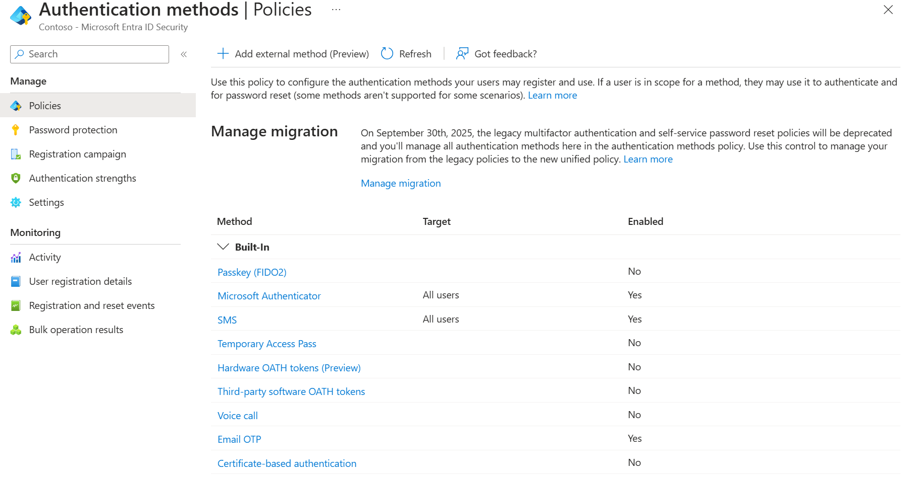
Is This Misconfigured?

Slide 2
Is This Misconfigured?

Slide 3
Is This Misconfigured?
It Depends…

Slide 4
Is This Misconfigured?
It Depends…
Regulation?
Policy?
Good Practice?
An Admin’s Opinion?

Slide 5
Is This Misconfigured?
It Depends…
Regulation?
Policy?
Good Practice?
An Admin’s Opinion?
We need context…
Over 20 settings

Slide 6
Is this misconfigured?
Gartner predicts that through 2025, more than 99% of cloud breaches will be traced back to preventable misconfigurations or mistakes by end users.
https://venturebeat.com/business/takeaways-from-gartners-2021-hype-cycle-for-cloud-security-report/

Slide 7
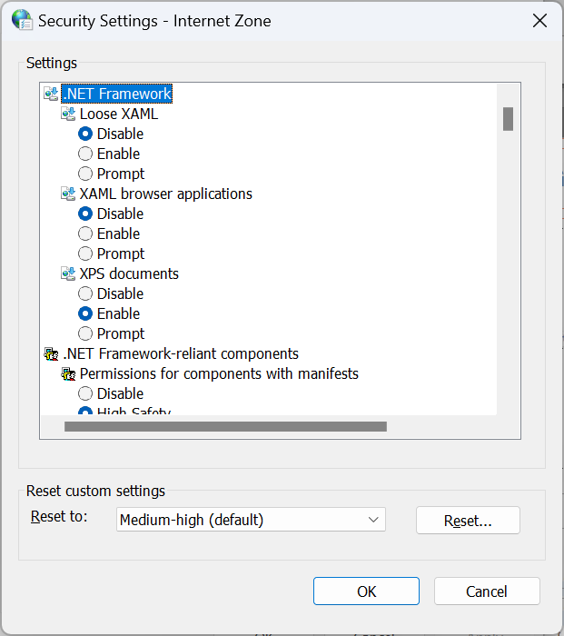
How do we get more context?

Slide 8
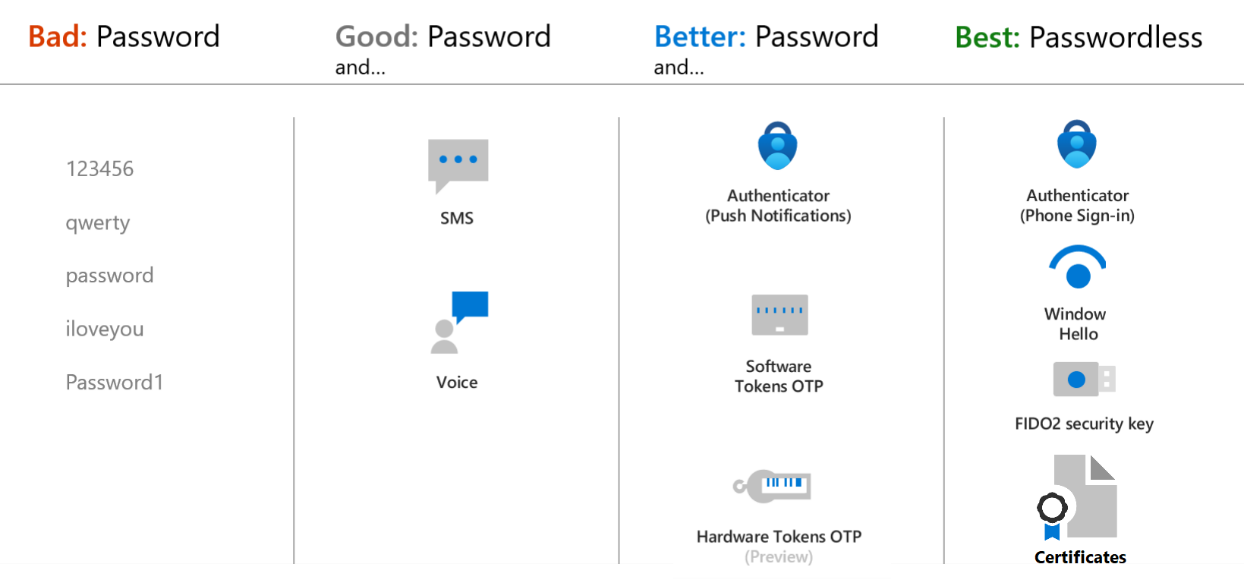
How do we get more context?
Provider Guidance
Microsoft’s guidance for authentication methods

Slide 9
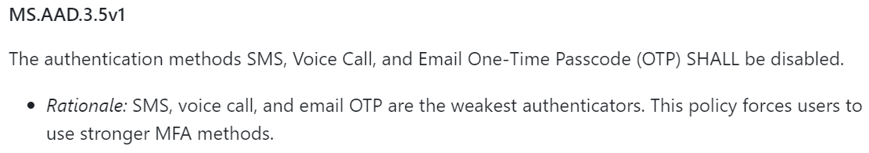
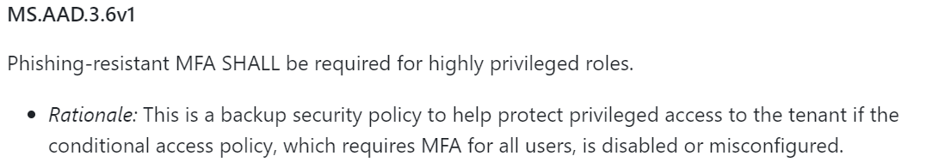
How do we get more context?
Provider Guidance
Microsoft’s guidance for authentication methods
Federal Agency Guidance
Cybersecurity & Infrastructure Security Agency’s (CISA) guidance

Slide 10
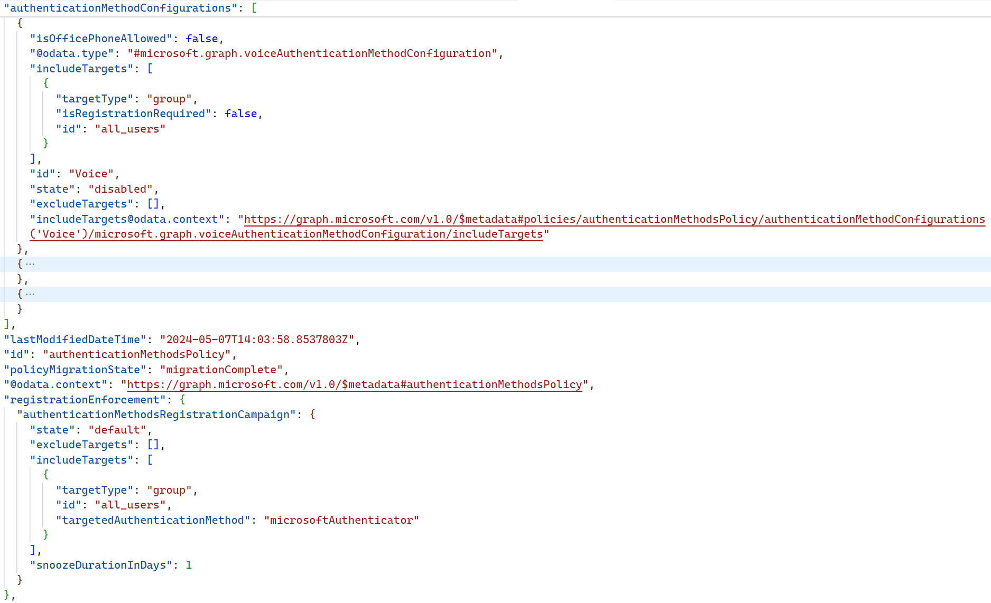
How do we get more context?

Slide 11
How do we get more context?
Only ~200 Lines of JSON

Slide 12
How Do We Get More Context?
Only ~200 Lines of JSON
Just 1 feature
In 1 product
100s of updates each month

Slide 13
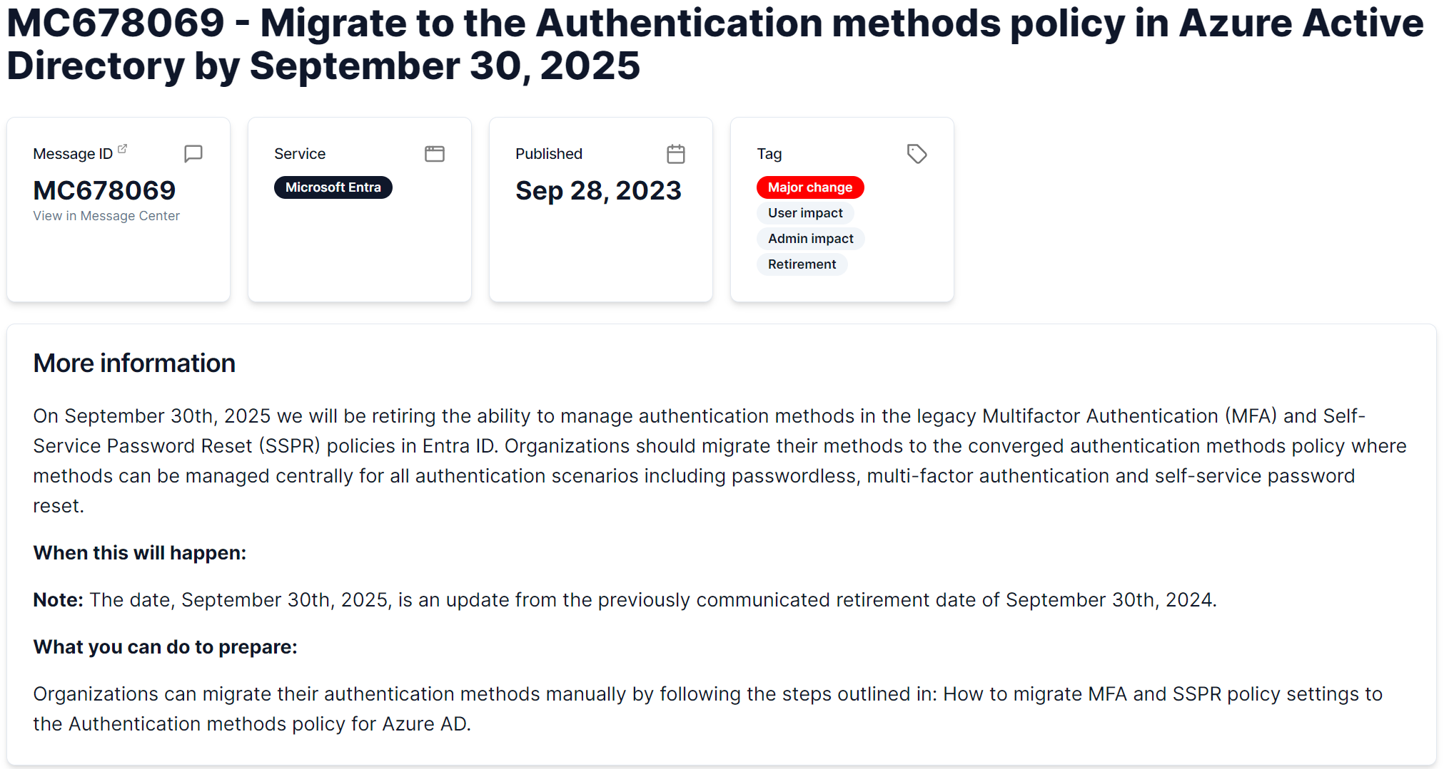
How do we get more context?
Only ~200 Lines of JSON
Just 1 feature
In 1 product
100s of updates each month

Slide 14
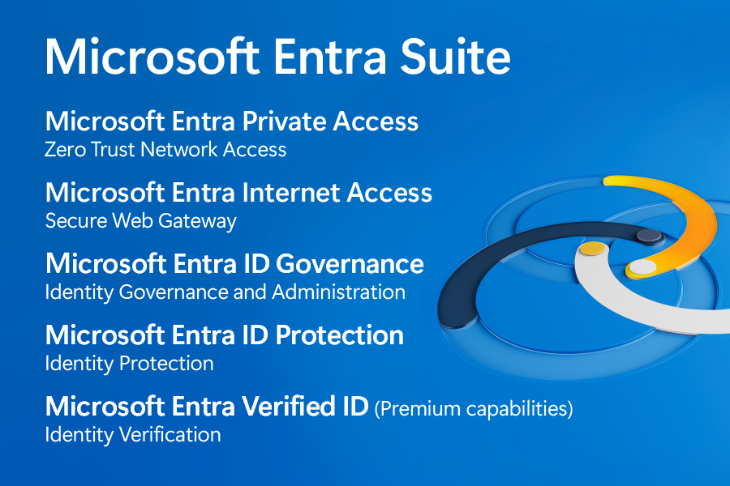
How do we get more context?
Only ~200 Lines of JSON
Just 1 feature
In 1 product
100s of updates each month

Slide 15

How do we get more context?
Only ~200 Lines of JSON
Just 1 feature
In 1 product
100s of updates each month

Slide 16
How do we get more context?
Only ~200 Lines of JSON
Improve
Security
Faster

Slide 17
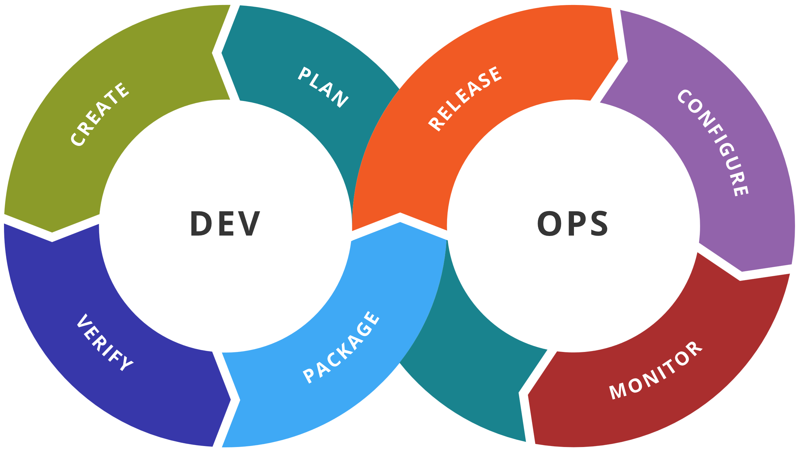
What is Continuous Integration?

Slide 18




What is Continuous Integration?
Change
Test
Review
Deploy

Slide 19
What is Continuous Integration?
Change
Continuous Integration
Test
Continuous Delivery
Review
Continuous Deployment
Deploy

Slide 20
What does Continuous Integration look like?
Change
Test

Slide 21
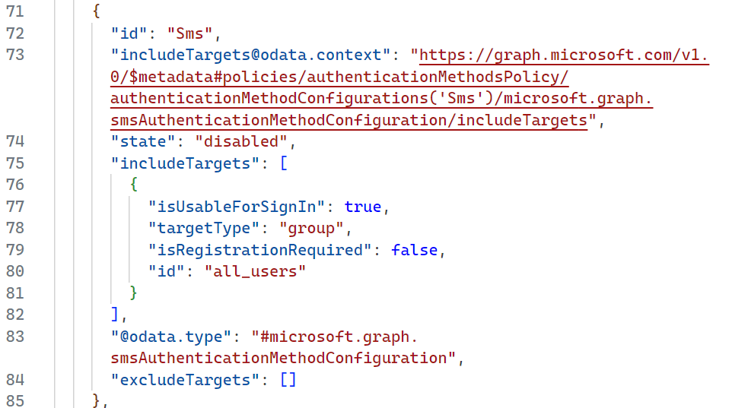
What does Continuous Integration look like?
Config as Code
Change
Test

Slide 22
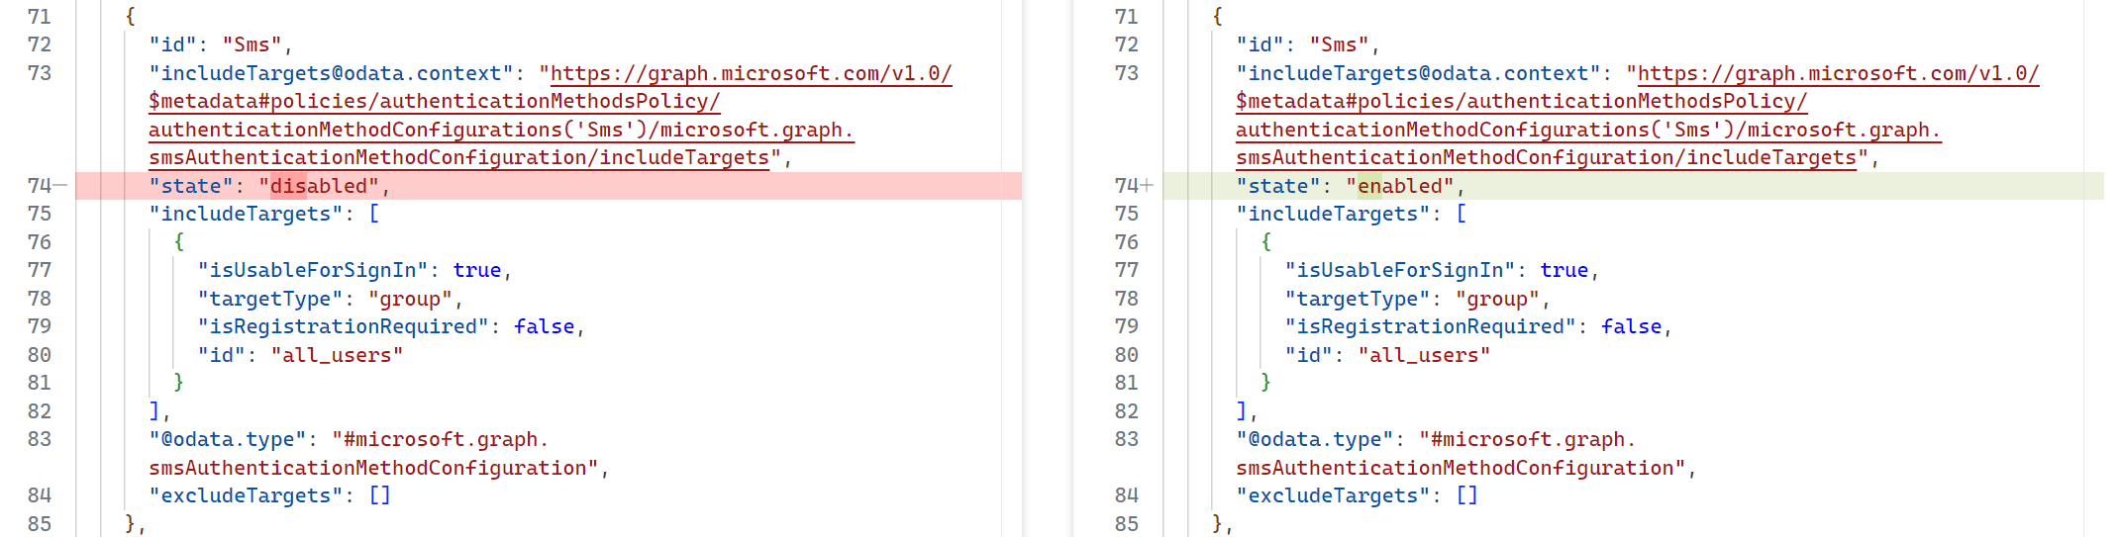
What does Continuous Integration look like?
Config as Code
Change Occurred
Change
Test

Slide 23
What does Continuous Integration look like?
Config as Code
Change Occurred
Change
Do we care?
Test

Slide 24
What does Continuous Integration look like?
Config as Code
Change Occurred
Change
Do we care?
Test
We need to test

Slide 25
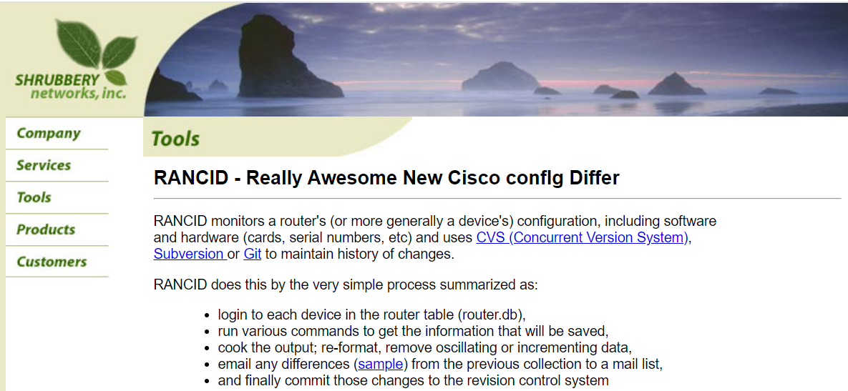
What does Continuous Integration look like?

Slide 26
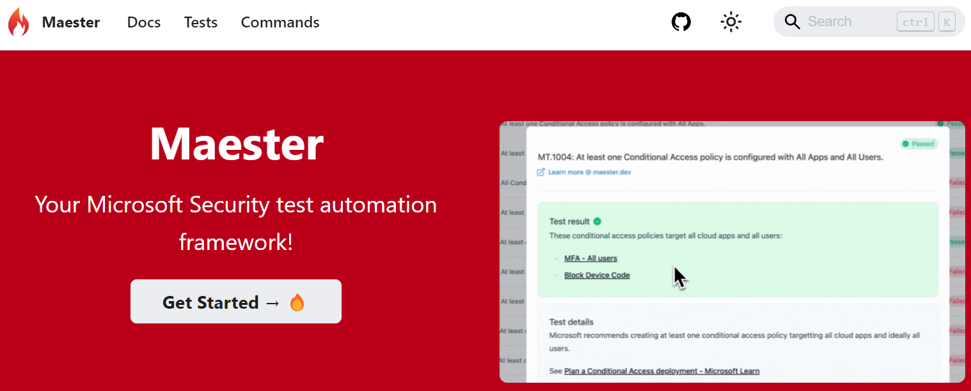

What about automating tests?

Slide 27
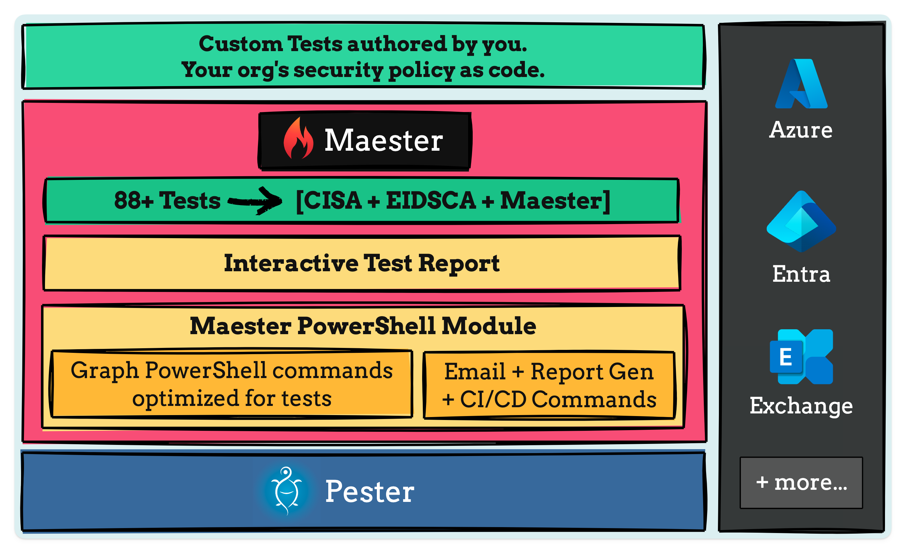
What is Maester?

Slide 28
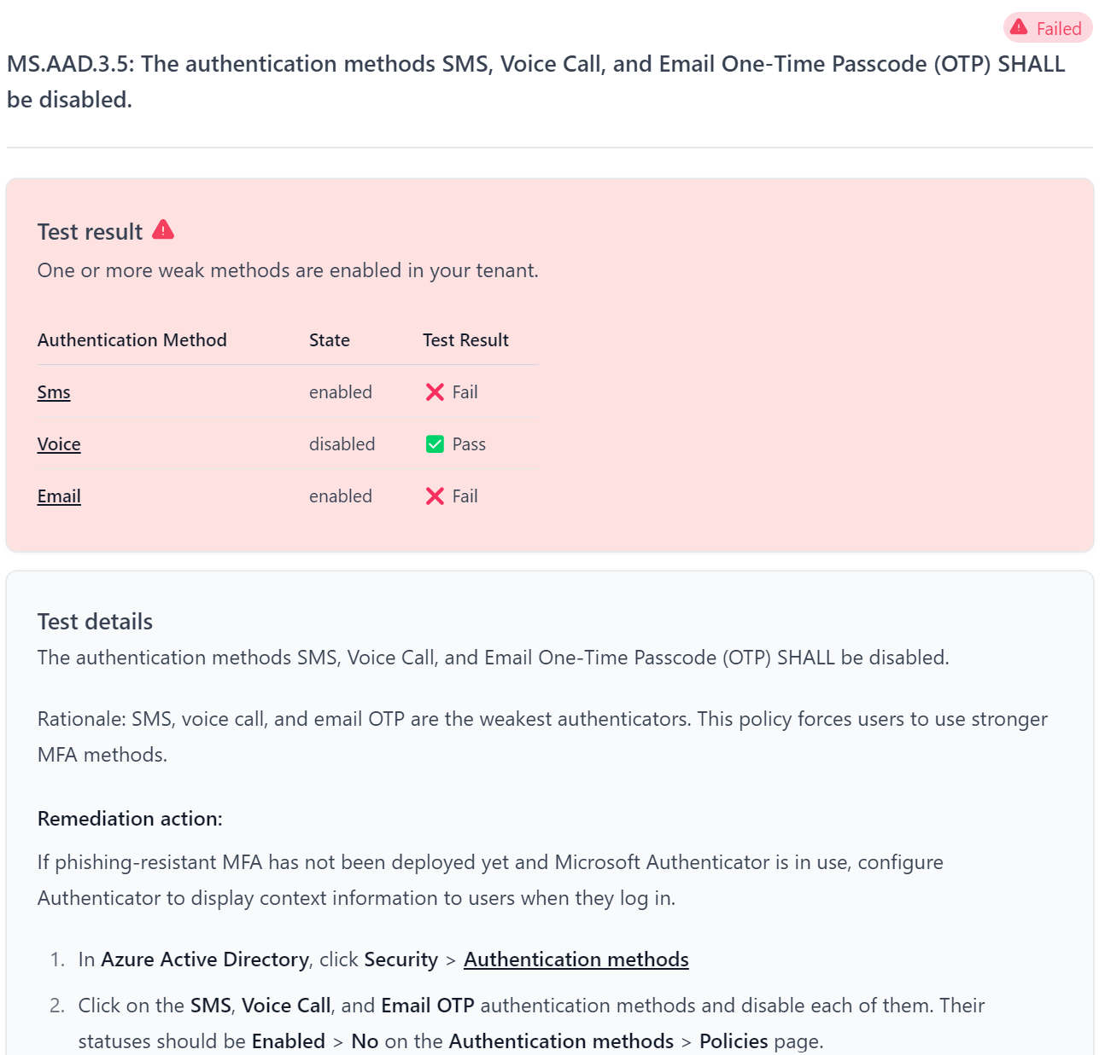
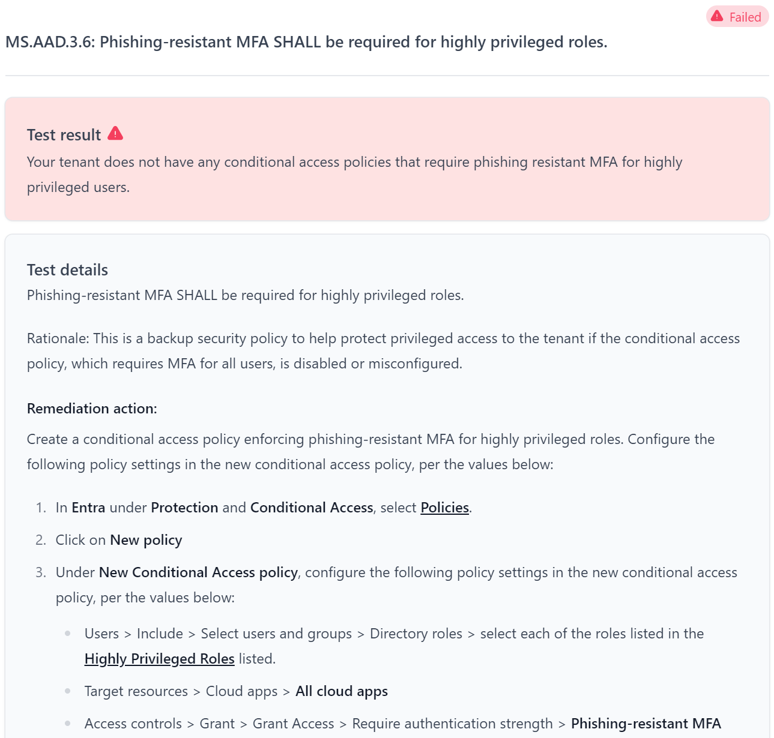
What is Maester?

Slide 29
What is Maester?

Slide 30
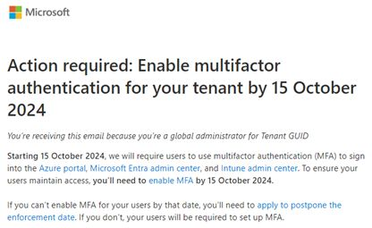
What is Maester?

Slide 31
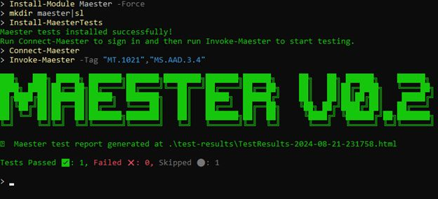
What is Maester?

Slide 32
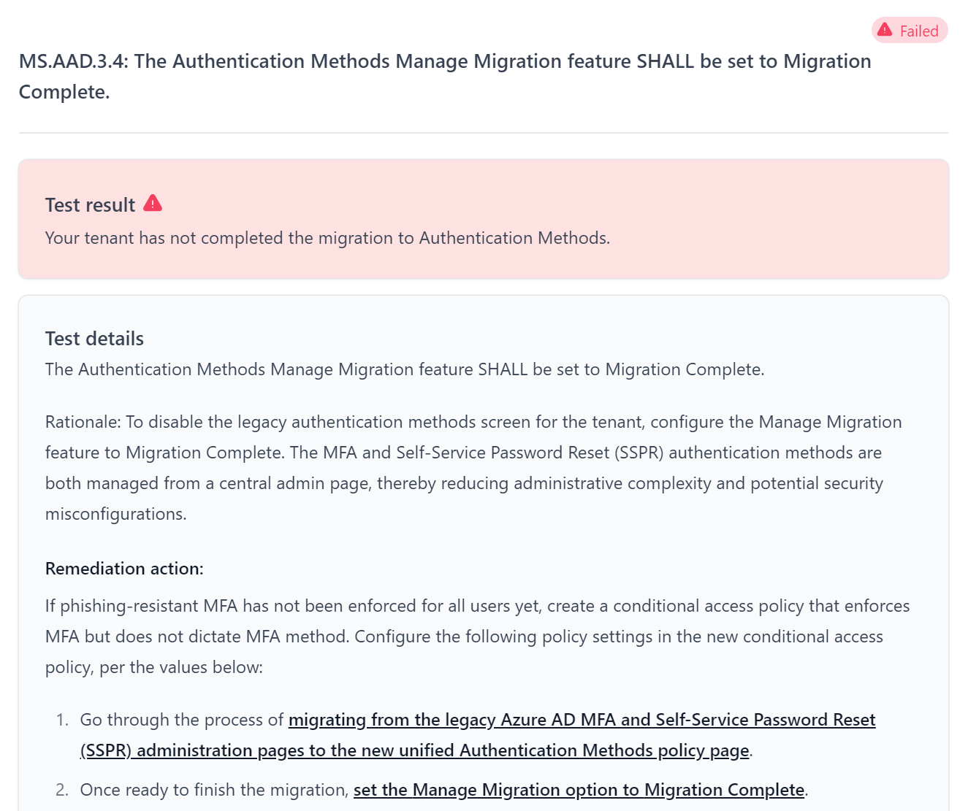
What is Maester?

Slide 33
What does Continuous Integration look like?
Config as Code
Change Occurred
Change
Do we care?
Test
We need to test

Slide 34
How can we make it faster?
There is a log for that

Slide 35




How can we make it faster?
There is a log for that

Slide 36
How can we make it faster?
There is a log for that
Diagnostic Settings
Management Activity API

Slide 37
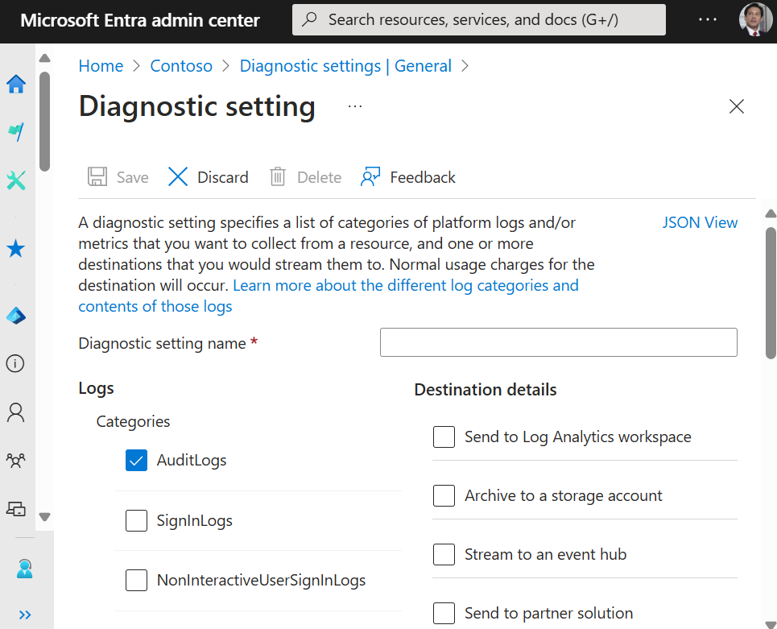
How can we make it faster?
There is a log for that
Diagnostic Settings
Management Activity API

Slide 38
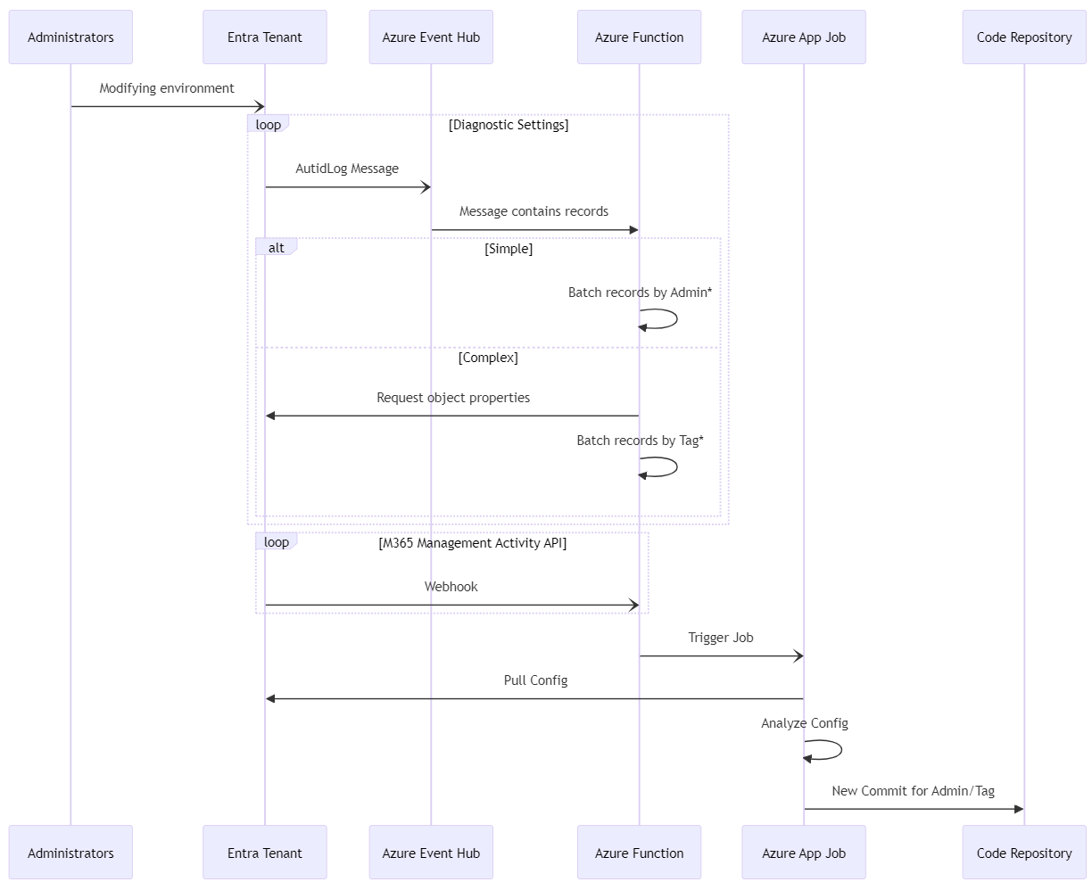
How can we make it faster?

Slide 39
How can we make it faster?

Slide 40

How can we make it faster?

Slide 41
How can we make it faster?
sequenceDiagram
participant Administrators
participant Entra Tenant
Administrators -) Entra Tenant: Modifying environment
participant Azure Event Hub
participant Azure Function
loop Diagnostic Settings
Entra Tenant -) Azure Event Hub: AutidLog Message
Azure Event Hub ->> Azure Function: Message contains records
alt Simple
Azure Function ->> Azure Function: Batch records by Admin*
else Complex
Azure Function ->> Entra Tenant: Request object properties
Azure Function ->> Azure Function: Batch records by Tag*
end
end
loop M365 Management Activity API
Entra Tenant -) Azure Function: Webhook
end
Azure Function -) Azure App Job: Trigger Job
Azure App Job ->> Entra Tenant: Pull Config
Azure App Job ->> Azure App Job: Analyze Config
Azure App Job ->> Code Repository: New Commit for Admin/Tag

Slide 42
Is that necessary?

Slide 43

Is that necessary?
Starting with monthly is great
You understand the…
Changes

Slide 44

Is that necessary?
Starting with monthly is great
You understand the…
Changes
Impact

Slide 45

Is that necessary?
Starting with monthly is great
You understand the…
Changes
Impact
Improve

Slide 46
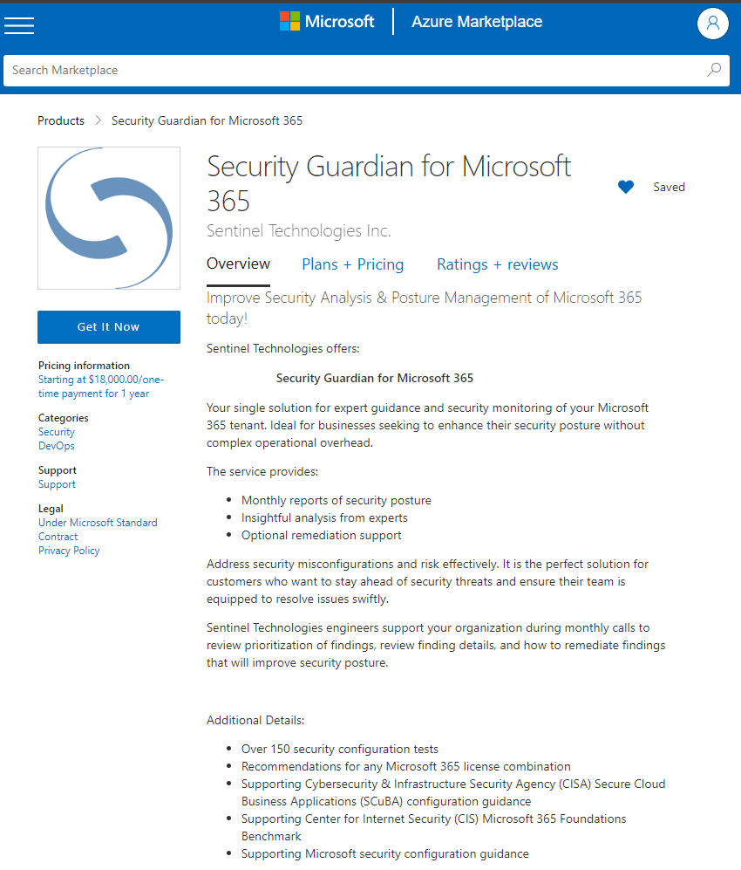
Is that necessary?
Starting with monthly is great
You understand the…
Changes
Impact
Improve

Slide 47
Is that necessary?
Starting with monthly is great
You understand the…
Sentinel will manage this
You benefit from…
Managed infrastructure
Guidance prioritizing
Support implementing
Improved security posture
Changes
Impact
Improve

Slide 48
Is this misconfigured?
Gartner predicts that through 2025, more than 99% of cloud breaches will be traced back to preventable misconfigurations or mistakes by end users.
https://venturebeat.com/business/takeaways-from-gartners-2021-hype-cycle-for-cloud-security-report/

Slide 49








Who is Michael Soule?
Michael Soule
National Director
Sentinel Technologies
misoule@sentinel.com
Migration & Modernization
Identity & Security
Hybrid Cloud
Licensing & Cost Optimization

Slide 50
Is that necessary?
Starting with monthly is great
You understand the…
Sentinel will manage this
You benefit from…
Managed infrastructure
Guidance prioritizing
Support implementing
Improved security posture
Changes
Impact
Improve

